Slide 1
Group 5 Project
Participants
1. Laura Kanda
2. Cynthia Jerono
3. George Chira
4. Ruth Kioko
5. Angela Maina

Slide 2
A Comprehensive Analysis Using Multiple Linear Regression Models
COUNTY REAL ESTATE CONSULTING COMPANY

Slide 3
TABLE OF CONTENTS
´Introduction
´Objectives
´Data Analysis and Cleaning
´Exploratory Data Analysis (EDA)
´Identified Key Features with Highest Correlations to House Prices
´Model Development
´Model Evaluation
´Recommendations

Slide 4
INTRODUCTION
Accurately predicting house prices is crucial for home-buyers and home-sellers to make informed decisions in the real estate market.
This project aims to equip homeowners with insights of the housing market in King County, Washington, by analyzing various features.
The features used to analyze house prices and develop a regression model were; Living space, quality grade, and the number of bathrooms.

Slide 5
KEY OBJECTIVES
01
02
03
04
Develop Accurate Predictive Models for House Prices: Create and evaluate multiple linear regression models.
Identify Key Factors Influencing House Prices: Analyze various features to determine their impact.
Provide Actionable Recommendations for Property Value Enhancement: Based on model results and feature analysis
Guide Homeowners and Real Estate Professionals: Optimize property quality and features to increase market value

Slide 6
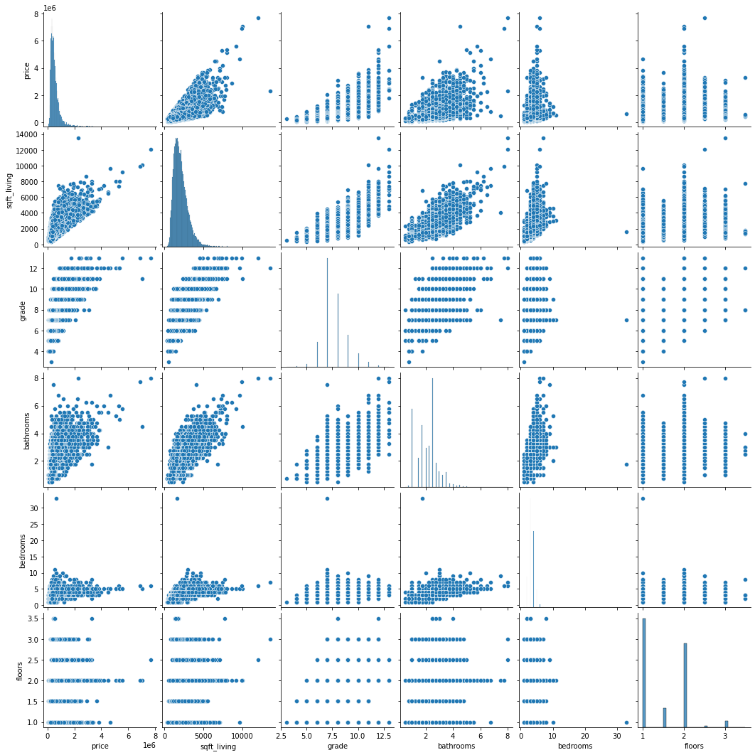
DATA UNDERSTANDING
The dataset used consisted of properties sold between 2014 and 2015
The columns used to make scatter plot models were :
Price - is prediction target
Bedrooms Number - number of Bedrooms per House
Bathrooms Number - number of bathrooms per house
sqft_livingsquare - footage of the home
Grade - overall grade given to the housing unit, based on King County grading system
From the scatter plots, linear relationships were determined, patterns identified and outliers detected

Slide 7
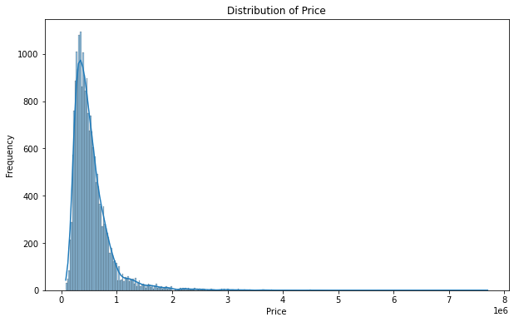
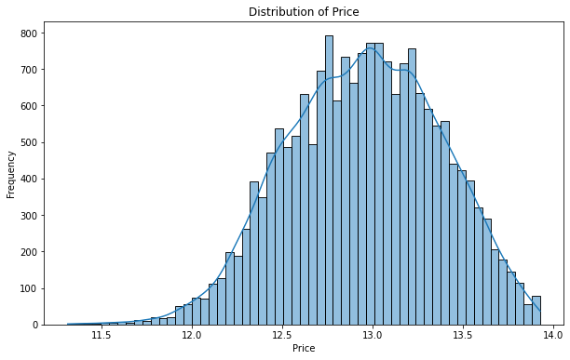
DATA CLEANING
Loading and Cleaning: Inputing missing values, removing outliers and removing duplicate values
Dealing with missing values in the Waterfront column- imputation method was used by finding the mode of houses with waterfronts
Below is a price distribution before and after cleaning and normalization

Slide 8
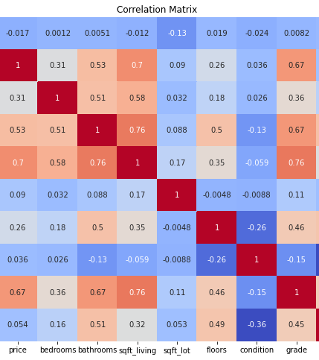
EDA- CHECKING FOR CORRELATION
´The heatmap on the right shows correlation of the selected features with price
sqft_living , grade and bathrooms have the highest effect on price for they have a correlation > 0.5
Condition, among other features have the low correlation thus not being used in our final model

Slide 9
FEATURE SELECTION
Criteria: Correlation coefficient
above 0.5
Selected Features: Living space, grade, number of bathrooms
Process: Based on correlation coefficients
Feature | Correlation Coefficient against Price
price | 1
grade | 0.667967
bathrooms | 0.525912
bathrooms | 0.525912
bedrooms | 0.308795
floors | 0.256811
sqft_lot | 0.089879
sqft_lot | 0.089879
yr_built | 0.053952
condition | 0.036061

Slide 10
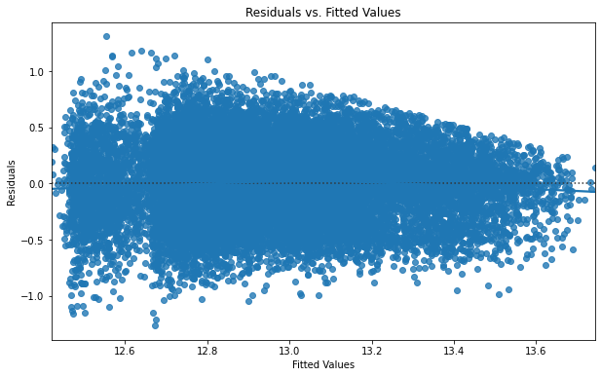
MODEL DEVELOPMENT
before model development was done, heteroscedasticity was tested and confirmed .
We had 4 linear regression models with an approach of increasing complexity
This was done by Incrementally adding features
Our goal was to Identify the most significant predictors.

Slide 11
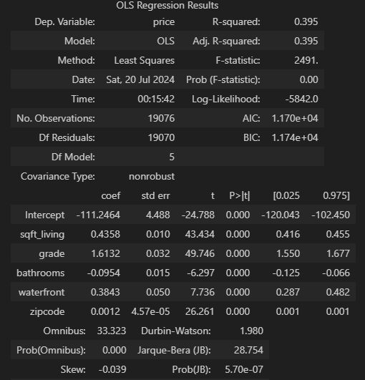
MODEL EVALUATION
The Mean Absolute Error (MAE) and R^2 were the metrics used to assess the models performance.
4 models were created :
Model 1(sqft_living & price): MAE = 0.291, R^2 = 0.305
Model 2(sqft_living, grade, price): MAE = 0.373, R^2 = 0.372
Model 3 (Sqft_living, grade, bathrooms, price): MAE= 0.273, R^2 = 0.374
Model 4 (all featured variables): MAE= 0.26 , R^2 = 0.395
The best performing model with the lowest MAE and highest R^2 was Model 4. It was further used to make predictions

Slide 12
RECOMMENDATIONS
1.Enhance Property Quality: Invest in improving the overall quality (grade) of properties. High-quality materials and design standards lead to substantial returns
2. Optimize Living Space: Increase living space (sqft_living) thoughtfully, ensuring additional space enhances functionality and appeal without unnecessary expansions.
3. Balanced Feature Development: Aim for a balanced approach in adding features like floors, bathrooms, and bedrooms. Focus on usability, aesthetics, and overall appeal to avoid potential negative impacts on house prices.
Implementing these recommendations helps stakeholders understand the factors influencing house prices and make informed decisions to enhance property value effectively.

Slide 13
CONCLUSION
Best Predictive Model: Model 4, using all features, is the most accurate and robust for predicting house prices. It balances prediction accuracy and explanatory power effectively.
Key Influencing Features: Grade is the most influential features positively affecting house prices. Enhancing property quality and optimizing living space can significantly increase property values.

